Slide 1

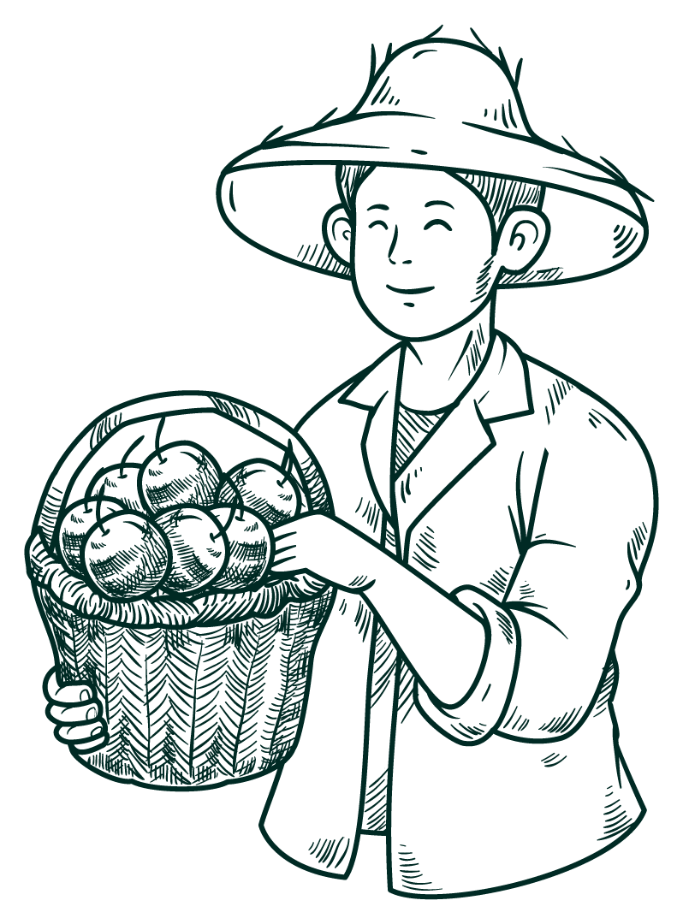



Harvesting.co
Leave No Farmer Behind
Presented by BlazeTech 🔥

Slide 2

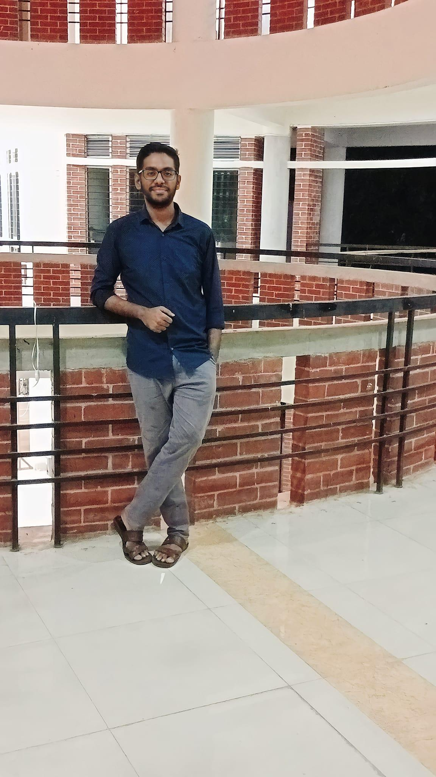

Blaze Tech Members
Tainur Rahaman
Mahidul Islam
Akibul Islam

Slide 3


contents
01
02
03
04
Process Model
Use Case Diagram
Activity Diagram
Sequence Diagram

Slide 4
Selected Process Model for the project
Spiral Model

Slide 5
Why Spiral Model?
Iterative Progression
Risk Mitigation
Flexibility in Requirements
Gradual development
User feedback
User-friendly refinement
Emphasis on risk management
Early issue identification
Systematic mitigation
Continuous communication
Iterative feedback
Agile responsiveness

Slide 6
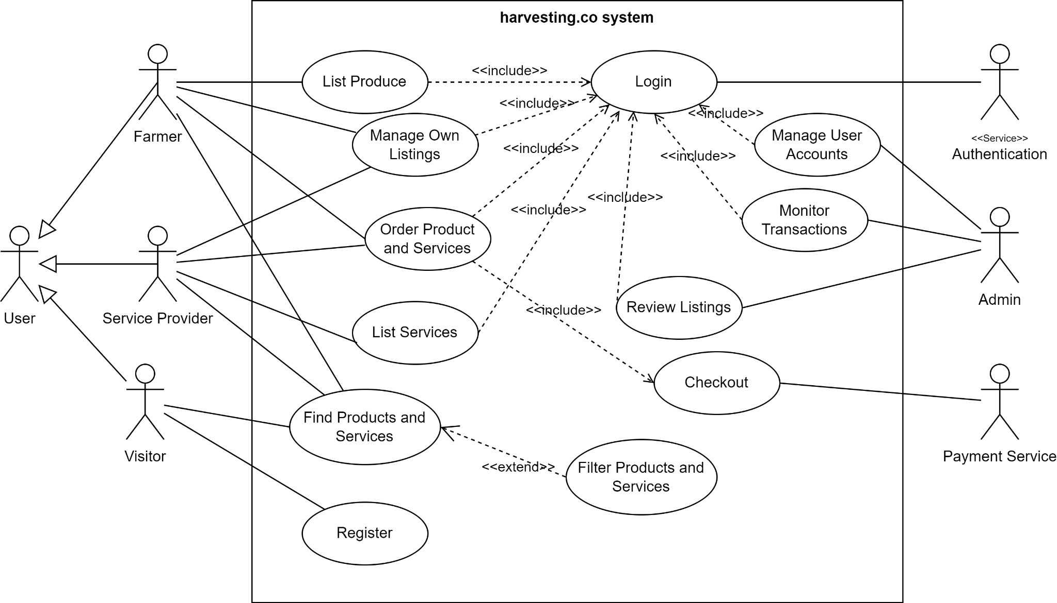
Use Case Diagram

Slide 7
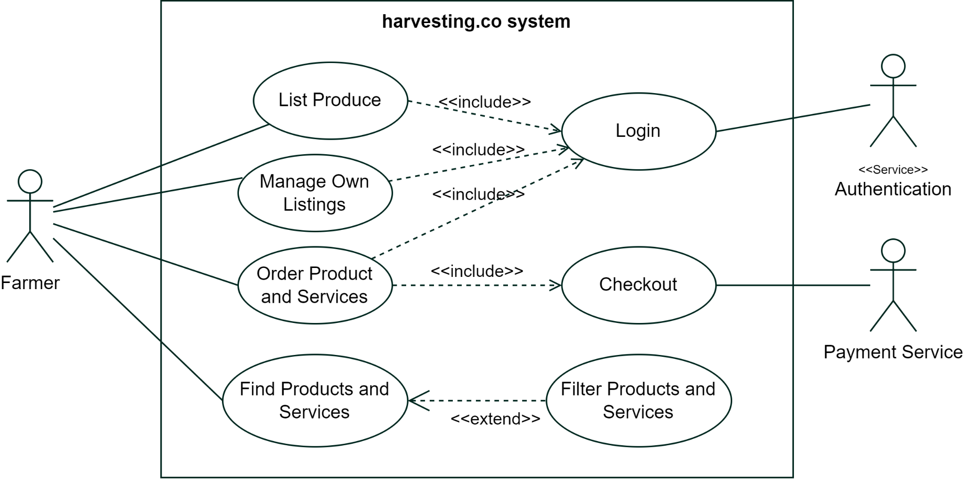
Farmer

Slide 8
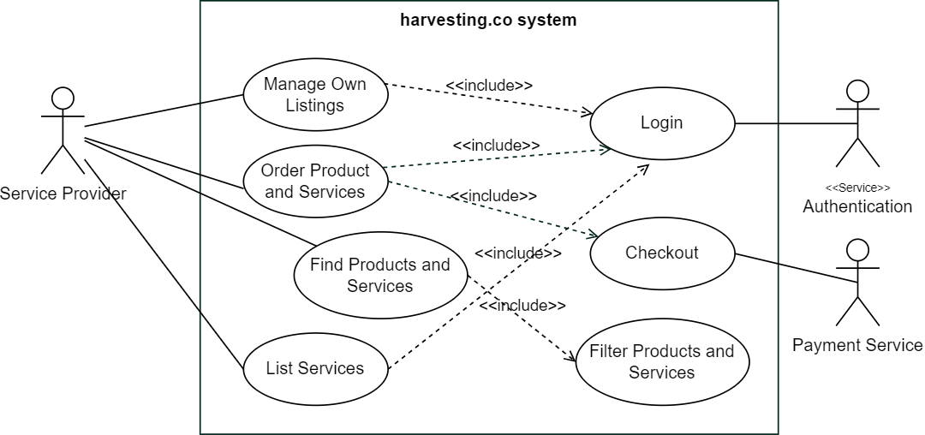
Service Provider

Slide 9
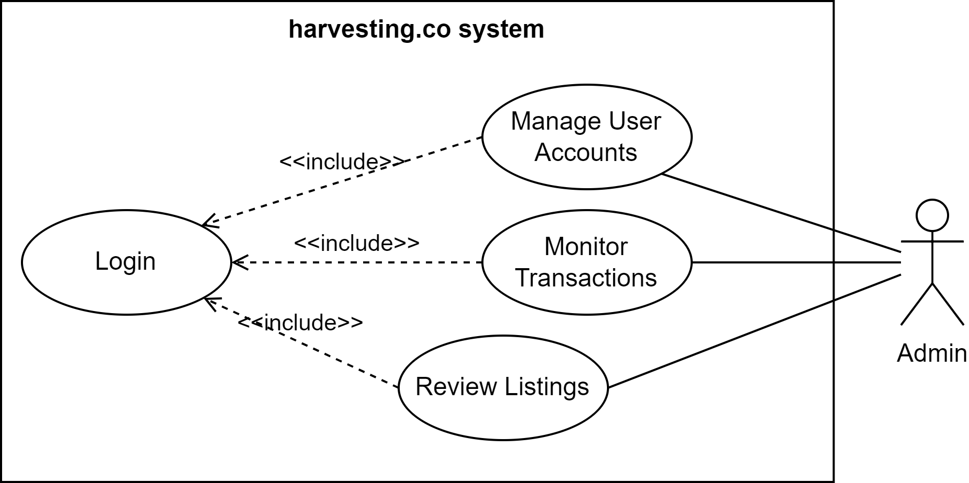
Admin

Slide 10
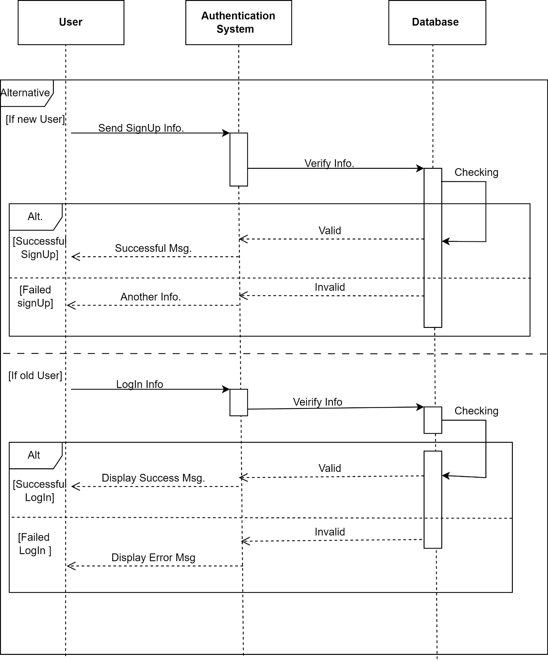
Register/Login Sequence Diagram

Slide 11
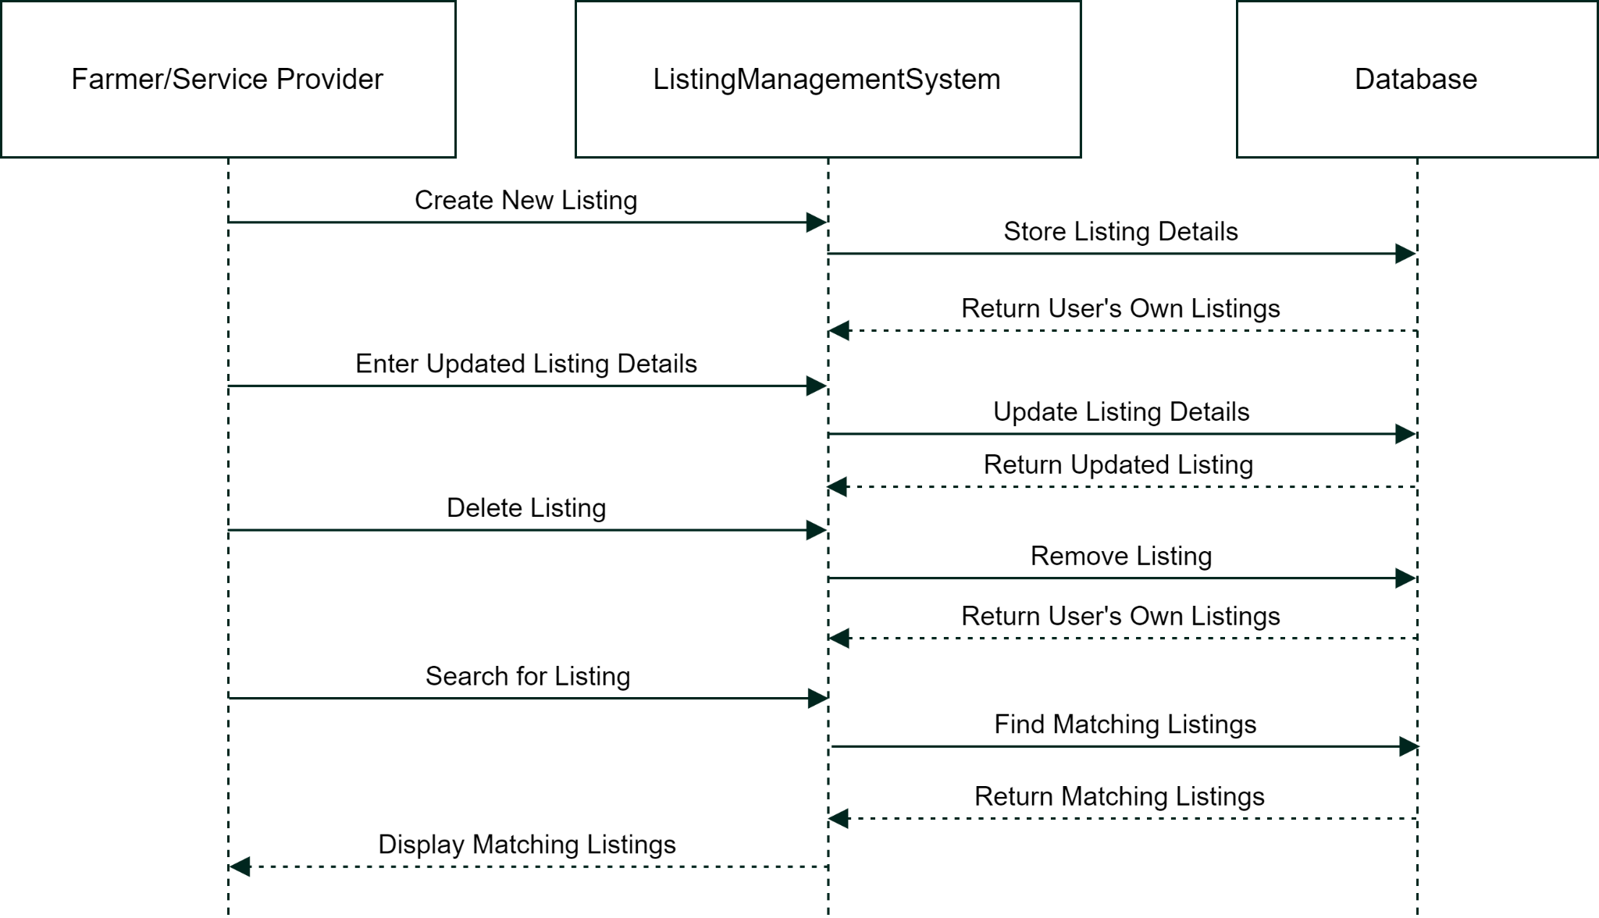
Product/Services Sequence Diagram

Slide 12
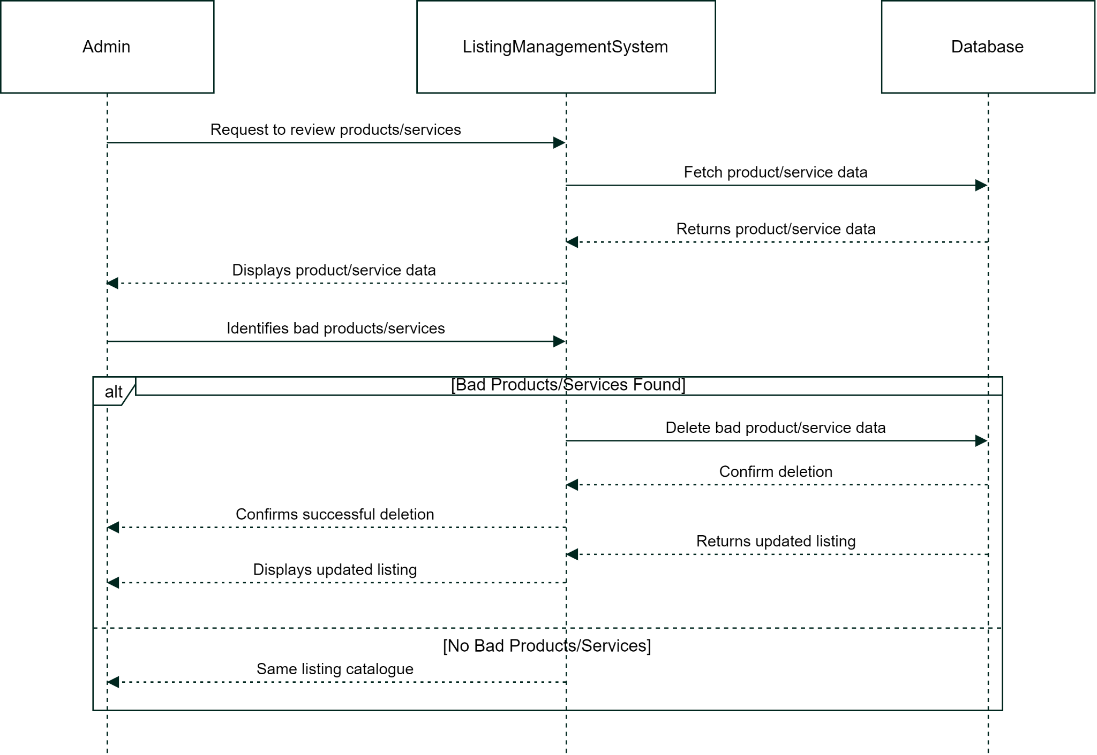
Admin Sequence Diagram

Slide 13
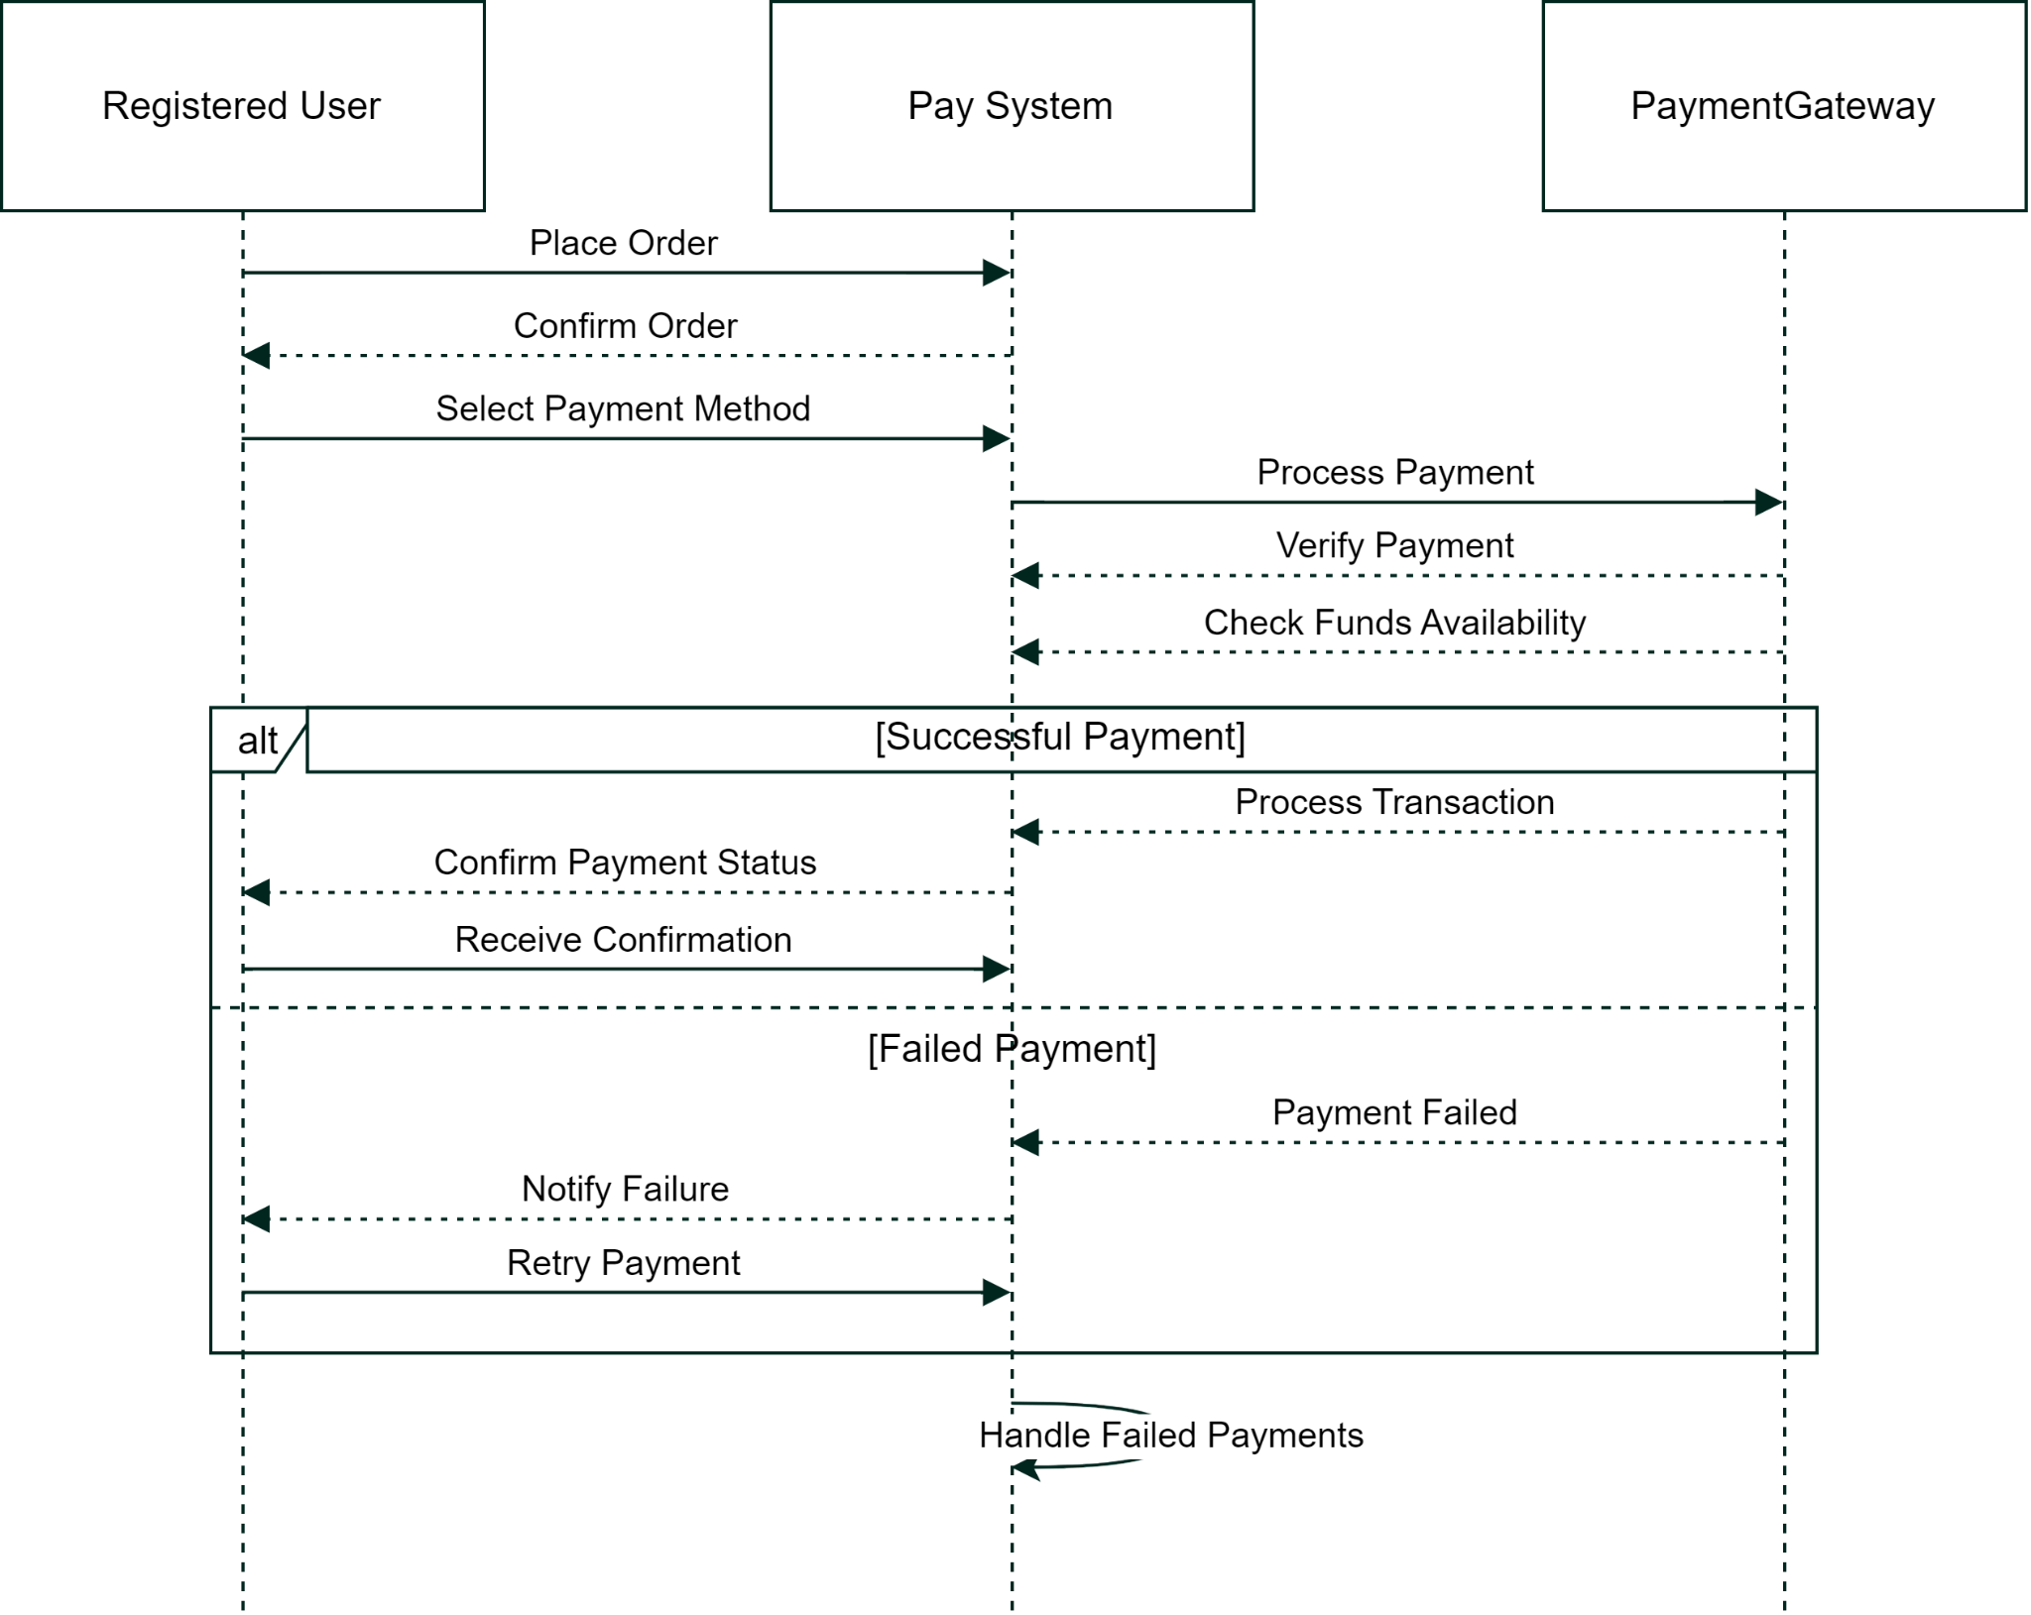
Payment Sequence Diagram

Slide 14
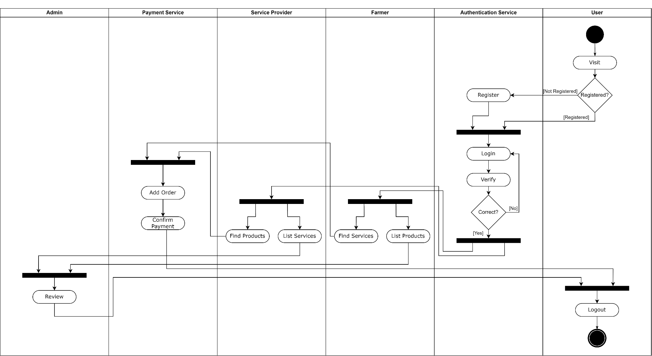
Activity Diagram

Slide 15



Does anyone have any questions?

Slide 16
Thank You

